Slide 1




MySears & MyKmart Communities
July 14, 2011 Casey Goddard
Swapnil Sharma

Slide 2
Community Overview
Vision: To provide an online community that replicates in-person interaction and conversation.
Customers and prospective customers access information, advice and tips around categories of interest from SHC associates, stores, vendors and fellow members while providing invaluable feedback and customer behavior understanding to SHC.
Guiding Principles:
Authenticity and transparency
Open dialog
Mutual respect
Best Practices:
Provide a meaningful experience for members
Integrate Brand Strategies Where Applicable
Strengthen Customer Engagement
Provide multiple ways to participate in the community
Leverage community feedback and insights
MyCommunities | Cumulative
Total Registered Members | 1,000,212
Unique Visitors | 37.9 million
Page Views | 89.4 million
Organic/Direct Traffic | 67.3%
Discussion Topics Created | 32,751
Discussion Posts Created | 190,850
Ideas Created | 4,430
Ideas Votes Created | 78,522
Attributed Revenue* | $11,414,480
Total Linked SYWR Accounts | 13,244
% of linked members contributing | 43%
Typical Member Contribution Rate | 18%

Slide 3
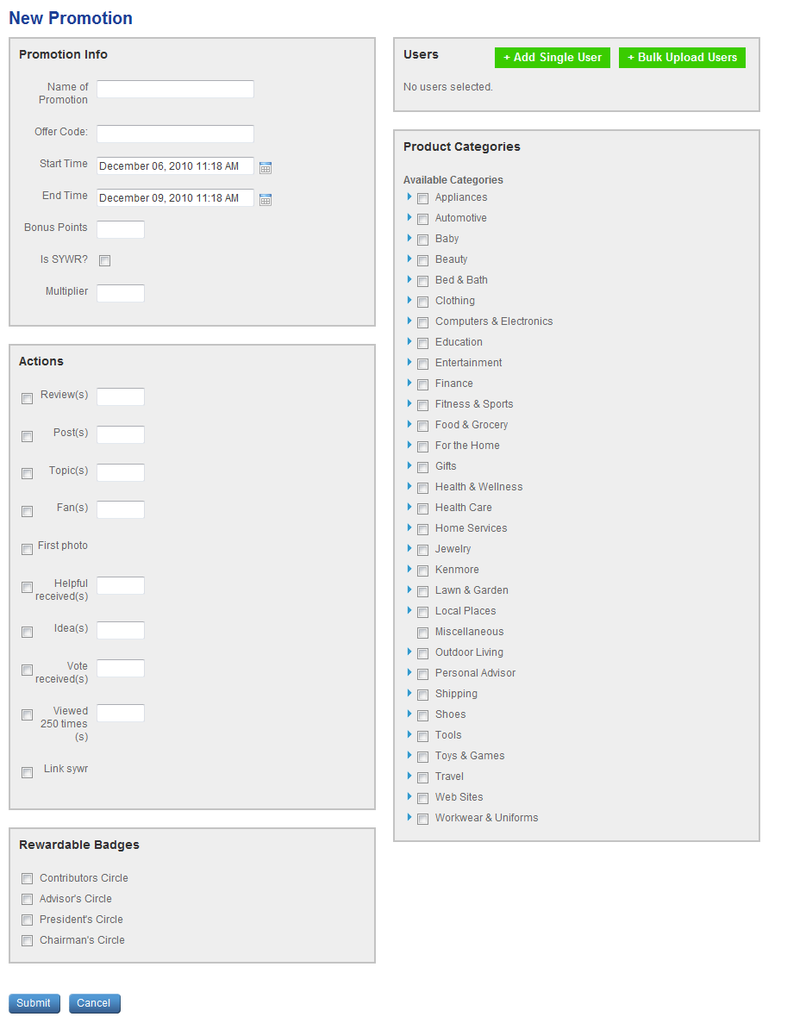
MyCommunities & SYWR: Current
MyCommunities and Shop Your Way Rewards joined together in 2010 to offer customers a unique community/loyalty experience that awards them for their contributions:
Community members can link their SYWR number to their community profile which enables them to earn SYWR points for participating in different community activities.
Points are awarded on a 1:1 basis, but only after they attain different levels in the Community Reputation Rewards* program:
Promotions Engine: allows the ability to create time sensitive promotions encouraging users to perform select actions on the community. When users perform the actions, they will then be awarded bonus reputation or SYWR points.
*see appendix
 | On My Community | Posted to SYWR
Minimum points to reach level | Pts earned in Calendar Yr | # SYWR Pts per badge |  | Ttl Pts in Calendar Year | $ Value per badge | $ Value in Calendar Year
Friend's Circle | 2,500 | 0 |  | 0 | $0.00 | $0.00
Contributor's Circle | 4,000 | 4,000 |  | 4,000 | $4.00 | $4.00
Advisor's Circle | 6,000 | 2,000 |  | 6,000 | $2.00 | $6.00
President's Circle | 25,000 | 19,000 |  | 25,000 | $19.00 | $25.00
Chairman's Circle | 50,000 | 25,000 |  | 50,000 | $25.00 | $50.00
Promotion Creation Interface

Slide 4
MyCommunities & SYWR: Current
Social Media Team Goals (July 2011 – January 2012):
1 MM SYWR members linked in SHC Community
1,000,000 product reviews
SYWR & Community is a powerful combination.
Proposals:
Deeper integration with community activities
Increase visibility of SYWR benefits across social channels
Continue to promote program and strengthen call to action on SYWR collateral, messaging, emails and websites.
Leverage SYWR business partner relationships to offer additional incentives
Build SYWR sign-up form in community for non-members
Other options? (Brainstorm)
-Unique Loyalty Program
-When connected drives extraordinary results.
-Limited interest in current program indicates need for better design and marketing
-Promote to SYWR Members
-Create new programs to earn points
-Leverage promotions engine
-Competitor loyalty programs catching on
-Limited internal support.
STRENGTHS
WEAKNESS
OPPORTUNITY
THREATS

Slide 5
Appendix

Slide 6
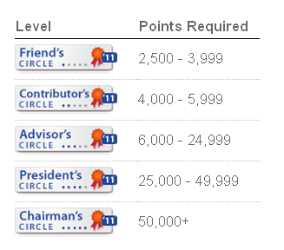
Reputation Rewards
The Recognition Rewards Program recognizes members for their contributions to the community. Members earn points by participating in various activities such as uploading a profile picture, writing a review, or gaining Fans in the community. All the earned points then contribute to an overall point total. A member’s point total determines their Level in the community and that Level is a way for fellow community members to see the most active members of the site.
Below are the various ways you can participate in the community and how many points you earn for each activity.
Activity | Points earned
Uploading a profile photo | 500 points
Writing your first review | 500 points
Writing additional reviews | 100 points
Bonus — if your additional review is >500 characters | 100 points
Submitting an idea | 50 points
Reads (When someone reads your review) | 25 points for every 250 reads
Fans (When someone adds you to their friends list) | 1 point (Limit 20x/month)
Receiving a helpful vote on your review | 10 points
Posting a forum topic | 10 points (Limit 10x/month)
Joining a forum discussion | 1 point (Limit 20x/month)
Receiving a vote on your idea | 1 point (Limit 20x/month)

